Slide 1
The Work Breakdown Structure
Adeaca PBA Feature Brief:
Manage and streamline every aspect of your project schedule

Slide 2
The Work Breakdown Structure and The Next Generation of Project Business Systems
Gen 1: Productivity tools
Gen 2:
Project ERP & Vertical Solutions
Gen 3:
Project Business Automation
Are you stuck using Generation one and two project applications?
Adeaca Project Business Automation is a third-generation project solution that brings your project and business needs together.
Unlike generation one and two solutions, PBA creates a completely integrated business system that supports project-driven processes and the associated business requirements from end-to-end.
Work Breakdown Structure in a Generation 3 System
As part of Adeaca PBA, the work breakdown structure provides unique capabilities that go beyond other solutions on the market. Generation 1 and 2 systems today use the work breakdown structure (WBS) as both the financial and operational hierarchy of the project which causes a major project governance flaw.
Due to the true integration of a generation 3 system, the WBS in Adeaca PBA eliminates the need for standalone project management applications and the overhead needed to manage them. The WBS is integrated into the rest of the project processes and systems.
Digitize project planning and scheduling
Consolidation of capabilities in one place
Process-first approach to project business with all project financials and operations in a comprehensive integrated business system
Focus
Focused on operational planning with the creation of PC productivity tools to manage the WBS.
Industry-specific project management applications emerge and the introduction of project accounting features in the ERP
Acquisition is not integration
Reinvention of known capabilities from the ground up to work seamlessly together results in a range of new and powerful capabilities
Introduction of project execution in the business system
Characteristics
Microsoft Project (1984)
Oracle Primavera (1983)
Excel (1985)
Deltek (1994) - Financials
IFS Applications (1993)
Procore (2002)
PSA (1997)
Adeaca PBA
Examples

Slide 3
The Work Breakdown Structure Summary
What is Project Scheduling in Adeaca PBA
Project Scheduling in Adeaca PBA, or the work breakdown structure (WBS), is a hierarchical outline of the tasks required to complete a project. The WBS “breaks down” the structure of a project into manageable deliverables.
The advantage of using a WBS as part of the project lifecycle management is that it takes large, complex projects and breaks them into smaller, more manageable tasks that can be assigned to specific people or teams to execute and deliver. Eliminate standalone project management applications and the overhead needed to manage them.
Leverage the project schedule to accurately build a labor budget, time-phase earned value estimates, and generate cash flow projections
Apply the timeline directly to MRP for production orders, and automatically constrain the schedule based on procurement or production delays
Staff projects more efficiently and automatically feed status updates, issues and work estimates back to the schedule from the timesheet
Report on the financial impact of schedule changes immediately
Purpose
The purpose of the WBS is to plan the schedule for the project.
The WBS is a central component of Adeaca Project Business Automation, as it acts as the primary schedule against which all other activities and system operations are executed. Each tasks duration is planned in conjunction with its required predecessors and following tasks. The WBS then provides an overall plan so that the project manager can see how the project should progress and manage the workflow appropriately.
Eliminate
Eliminate standalone project management applications and the overhead needed to manage them.
Leverage
Leverage the project schedule to accurate build a labor budget, time-phase earned value estimates, and generate cash flow projections.
Report
Report on the financial impact of schedule changes immediately.
Notes:
Data –> Analysis (criteria/judgement/what is good and bad) -> Alerts to right people at right time

Slide 4
Problems the Work Breakdown Structure in Adeaca PBA Solves
Managing projects in disparate applications results in projects delivered late and over budget.
Difficult to manage project workflow
Project data is disconnected
Lack of visibility and control
Potential issues get overlooked
When the work breakdown structure is not integrated into the rest of your project processes and systems, it’s difficult to manage project workflow across multiple business dimensions.
Without a truly integrated project business system, any changes to the project schedule or timeline is often miscommunicated or not conveyed in a timely manner.
The problem with project operations when managed in isolated tools and applications is the larger organization remains unaware of the operational state of projects. Oftentimes the project plan is maintained in one system, but the timeline is invisible to team members and other departments.
In project management, early detection is key. Detecting potential issues and risks early means the faster and more cost effectively you can respond. The only way to mitigate project risk is through transparent and proactive project business management with a fully integrated scheduling system.

Slide 5
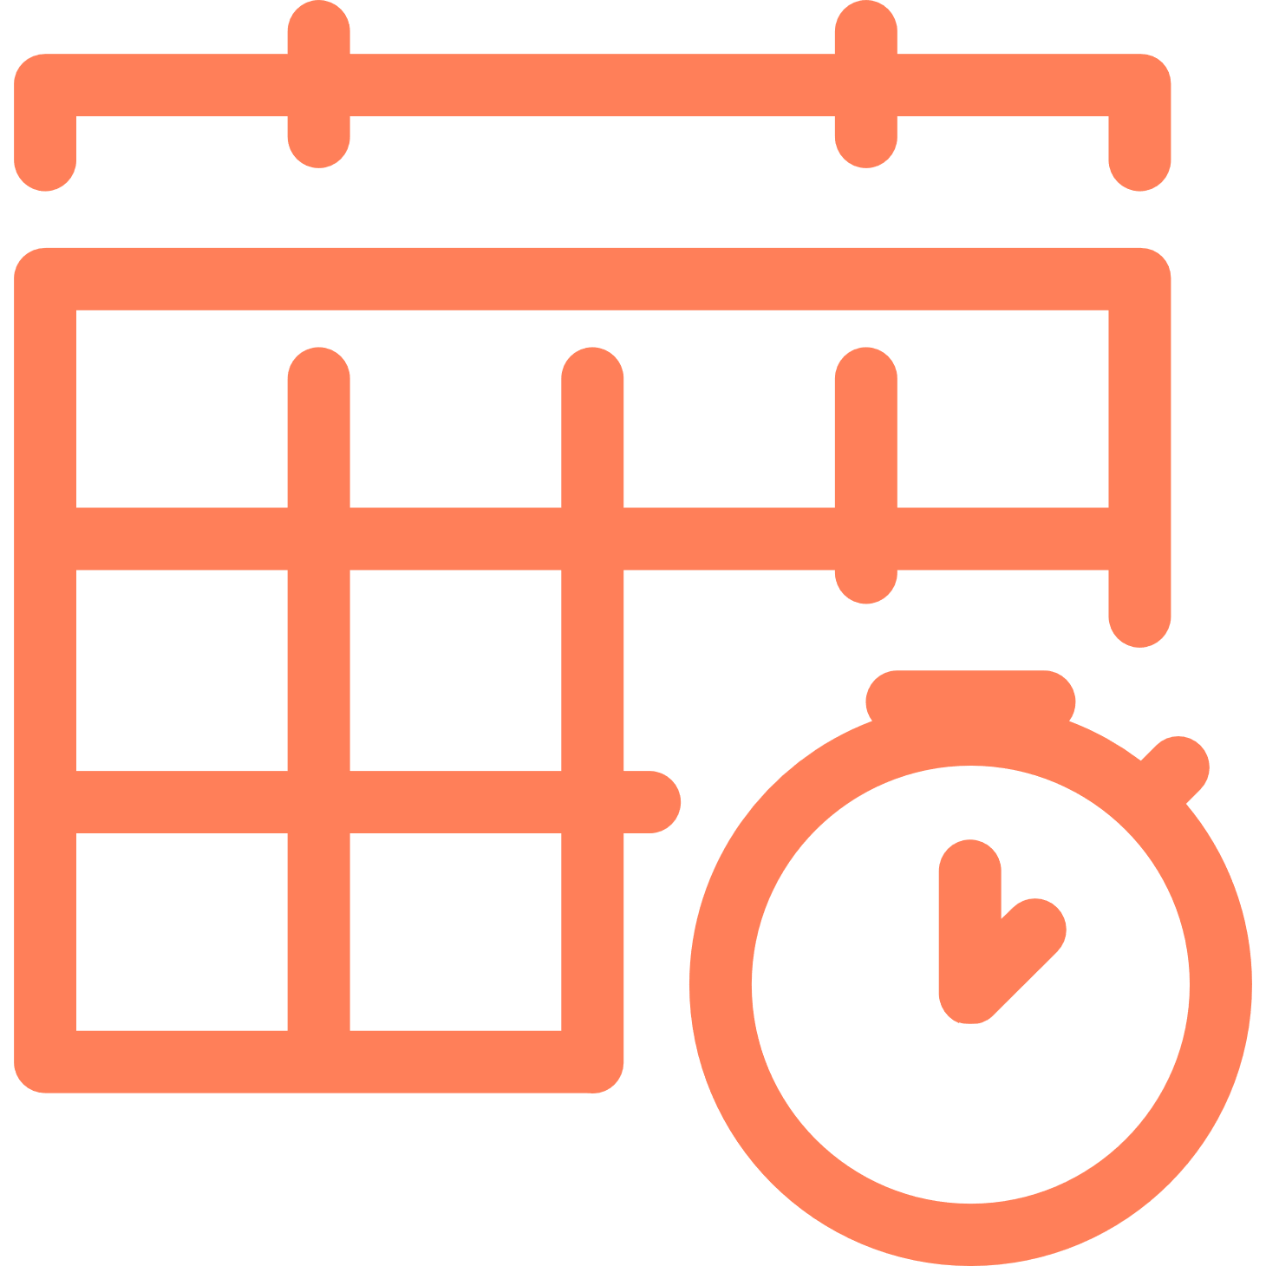
How the Work Breakdown Structure Helps You
Project timeline is managed with the rest of your business processes
As part of Adeaca PBA, the project timeline is managed inside the ERP, allowing connections between the schedule and timesheets, procurement and production, and costing and billing. This ensures schedule changes do not go unnoticed but rather align the entire organization and provides company-wide visibility and transparency.
Reduces the risk of schedule disruptions
Ancillary activities that are based on the always current project plan, ultimately reduces the risk of schedule disruptions. This increases the likelihood that deadlines are met. This alignment elevates the role of project planners from simply planning to providing the master timeline against which everyone else plans their activities.
Real-time visibility and control
As part of a third-generation project business system, the work breakdown structure is integrated with all other project data on one platform and provides real-time visibility in the status of your projects. This allows you to make better decisions based on accurate, timely data.

Slide 6
Work Breakdown Structure Use Cases
Use case | Align your project schedule with costs | Promote better collaboration | Streamline the MRP process
Description | As part of Adeaca PBA, the WBS allows you to leverage the project schedule to accurately build a labor budget, time-phase earned value estimates, and generate cash flow projections. | Project team members are presented with current assignments for easy, error-free time recording since the timesheet interacts directly with the WBS. | The delivery schedule of purchase and production orders align with the project plan. If delays are encountered in procurement or production, these are automatically applied as material constraints against the schedule.
Target Audience | COO, Operations Exec, PMO | COO, PMO, Operations Exec, PM Director, PM | COO, PMO, Operations Exec
Business Benefit | By using the WBS to manage project operations in parallel with the CBS to manage project financials, any changes in the schedule is immediately reflected on the costing sheet. | Status updates, issues and remaining work estimates can be fed back to the schedule directly from the time sheet, facilitating real-time collaboration between the planner and project managers. | Identifying any deviations in procurement or production early on, provides plenty of time to make the necessary adjustments and reduce the disruptions to the overall project.

Slide 7
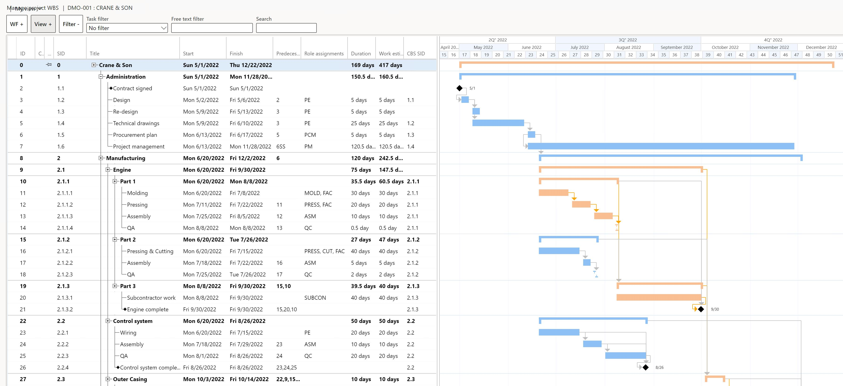
Advanced project planning and schedule management
A work breakdown structure and planning engine integrated with the rest of your business processes
Adeaca PBA provides an advanced project scheduling engine on par with Microsoft Project and far exceeding the capabilities found in Project Online. Adeaca PBA scheduling provides direct real-time integration with project financials, accounting, and resourcing.
Drag and drop
Capacity constraints and leveling
Milestone and deadline tracking
Gateway reviews
Critical path
Resourcing status
Progress tracking
Notes:
Replace Project Online MS Project
Selected project online couple years ago
15 different types of projects
Basic, moderate and complex
10% adoption - adoption key
Want most projects done inside ERP
Project Online - complexity?
Client driven requirements
Exceptions

Slide 8
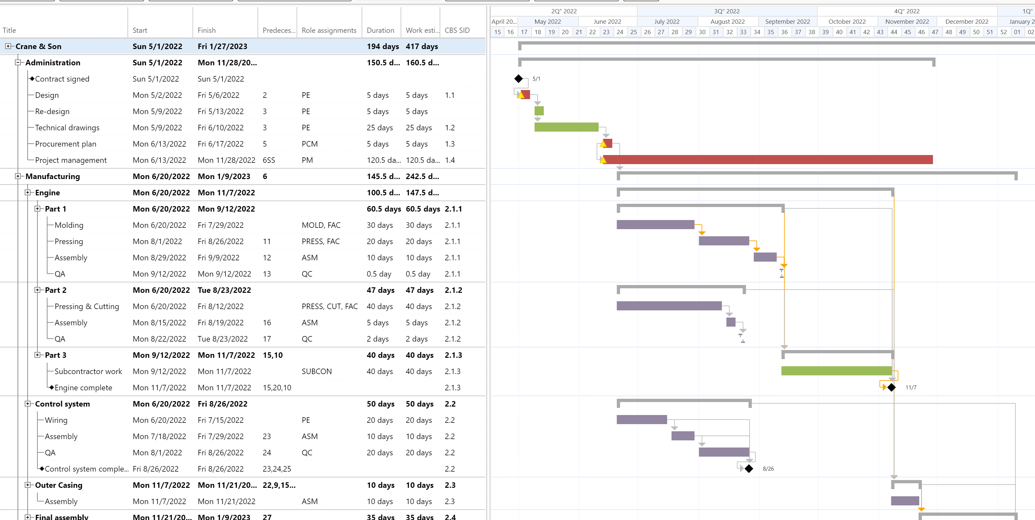
How the Work Breakdown Structure Works
Easily assign resources across departments and entities
Whether you need to leverage resources for projects from different departments within the same company or across different companies, the WBS in Adeaca PBA gives you the power to efficiently leverage those resources through a centrally managed resource sharing tool. Through the resourcing status display mode in the WBS, project managers have complete visibility into the resource status of all projects.
Project resourcing and resource dispatch board
Skill and availability-based resource selection across departments and companies
Resource departments segregation
Integrated resource cost and billing groups
Loan requests, approvals and loan change requests
Inter-company time, expense and remaining work reporting
Staffed with no conflicts
Staffed with conflicts
Unstaffed

Slide 9
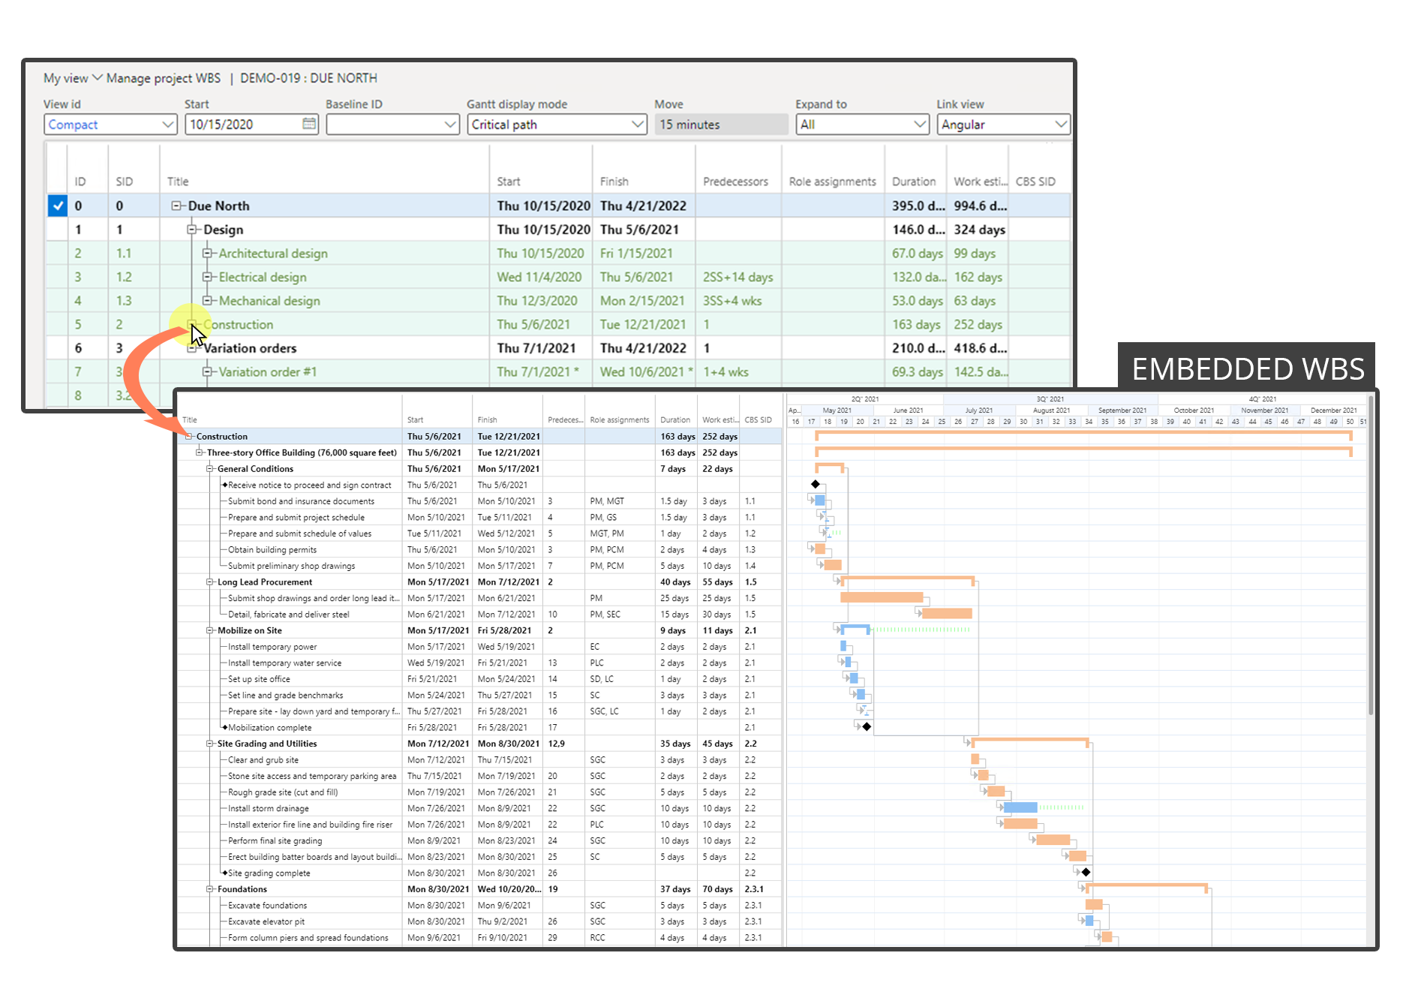
How the Work Breakdown Structure Works
Manage big project work with precision and transparency
Managing complex projects with thousands of tasks is highly inefficient. As part of Adeaca PBA, the Project Breakdown Structure provides another level of operational management that allows planners and task owners to manage their parts of the project simultaneously and independently, enabling greater workflow manageability.
Planners/managers work on their parts of the project separately and concurrently
Instantly summarize work estimates, durations, milestones and deadlines
Parent and embedded schedules sync automatically
Constraints and schedule changes flow up and down the structure
Workflows are detailed enough for each title task owner yet manageable across the entire project
Creates clear areas of work responsibility
Notes:
versions with and wit

Slide 10
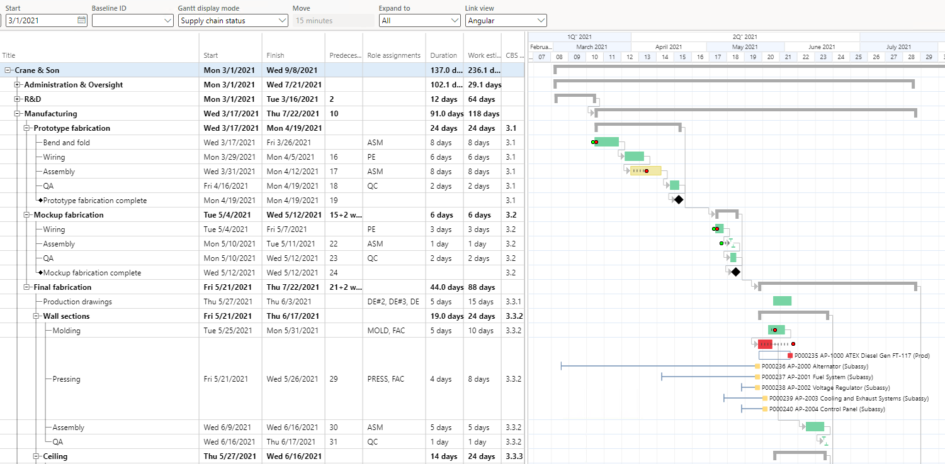
How the Work Breakdown Structure Works
Project timeline applied directly to MRP process
As part of the WBS, the project timeline is directly applied to the MRP process for production orders, and automatically constrains the schedule based on procurement or production delays.
No more discovering a problem too late causing further delays and budget overruns
Determine if the project task is going to be completed early, on time, or late
Compare when you can expect to get the materials needed for the task to the original expected date
Red flag indicates materials will not be delivered in time for this task

Slide 11
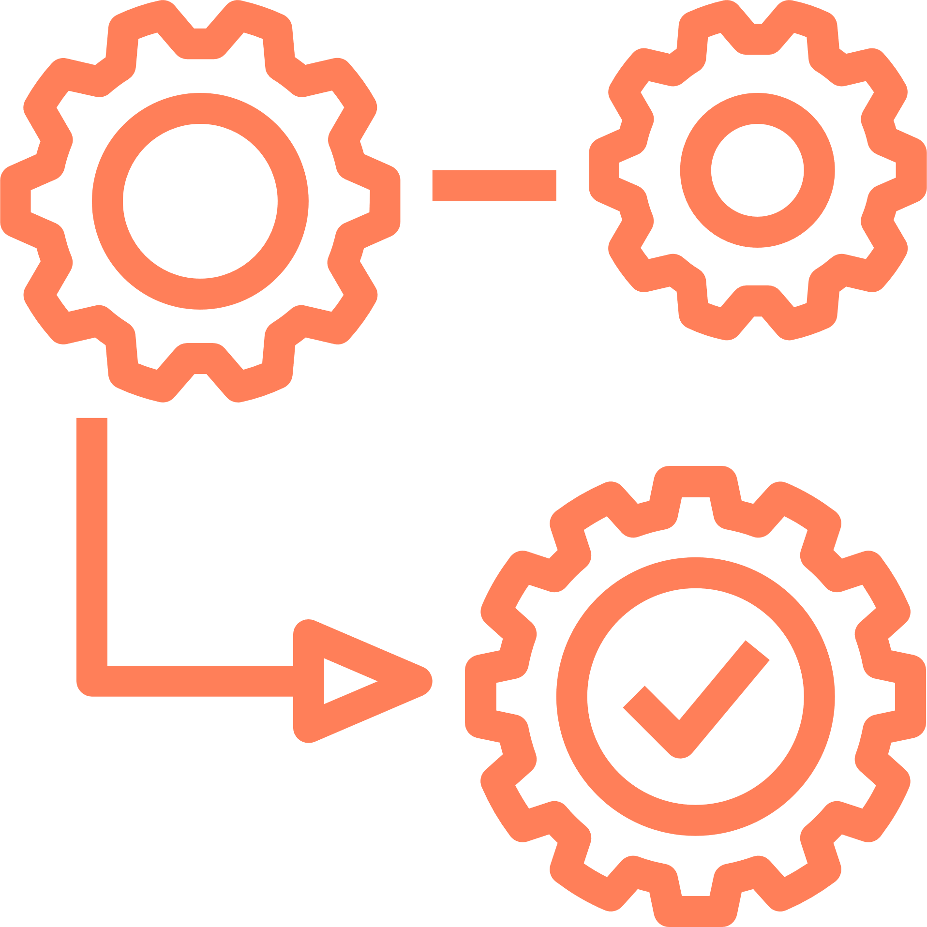
Business Value
When adopting new technology, it needs to lead to better business performance. Every feature of Adeaca’s Project Business Automation solution is designed with the end business value in mind. The Work Breakdown Structure is no different. Here is how the Work Breakdown Structure delivers real value to your project business.
Better Cost Control
The Work Breakdown Structure is integrated into the rest of the project systems and runs parallel to the Cost Breakdown Structure so you can better manage costs and conduct real-time financial analysis directly connected to the WBS, ultimately ensuring projects are delivered on time and on budget.
Enhanced Risk Readiness
As part of Adeaca PBA, the Work Breakdown Structure enables you to identify, analyze, and respond to risk faster so you can take mitigating actions faster. The WBS mitigates project risk through transparent and integrated schedule management.
Improved Delivery
The Work Breakdown Structure can be constrained automatically based on procurement or production delays. You can assign the most efficient resource for the task, better plan your resource demand into the future, and discover costly bottlenecks or conflicts early, ensuring projects are delivered on time.

Slide 12
Is Project Business Automation Right for You?
Take the PBA Fit Assessment
Takes only a few minutes
Quickly discover if your company is a fit for PBA
Determine how PBA will add value to your business
Take the PBA Fit Assessment

Slide 13
The Architects
Our mission at Adeaca is to make enterprise software work for project business. To that end, we created the first Project Business Automation system, providing an all-in-one business management solution for project-driven business.
We are revolutionizing project business management and we’re here to help solve your greatest project business challenges.
Learn more:
www.adeaca.com
sales@adeaca.com
+1 844 589 2053

